Slide 1
CAPÍTULO 12
RADIAÇÃO:
PROCESSOS E PROPRIEDADES
TRANSMISSÃO DE CALOR E MASSA

Slide 2
Radiation: Processes and Properties
-Basic Principles and Definitions-
Chapter 12
Sections 12.1 through 12.3

Slide 3
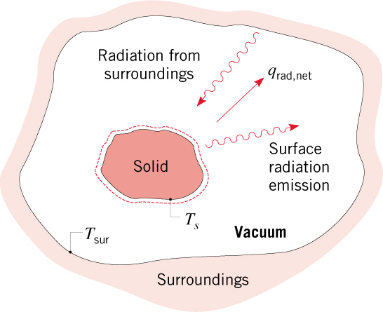
General Considerations
General Considerations
Attention is focused on thermal radiation, whose origins are associated
with emission from matter at an absolute temperature
Emission is due to oscillations and transitions of the many electrons that comprise
matter, which are, in turn, sustained by the thermal energy of the matter.
Emission corresponds to heat transfer from the matter and hence to a reduction
in thermal energy stored by the matter.
Radiation may also be intercepted and absorbed by matter.
Absorption results in heat transfer to the matter and hence an increase in thermal
energy stored by the matter.
Consider a solid of temperature
in an evacuated enclosure whose walls
are at a fixed temperature

Slide 4
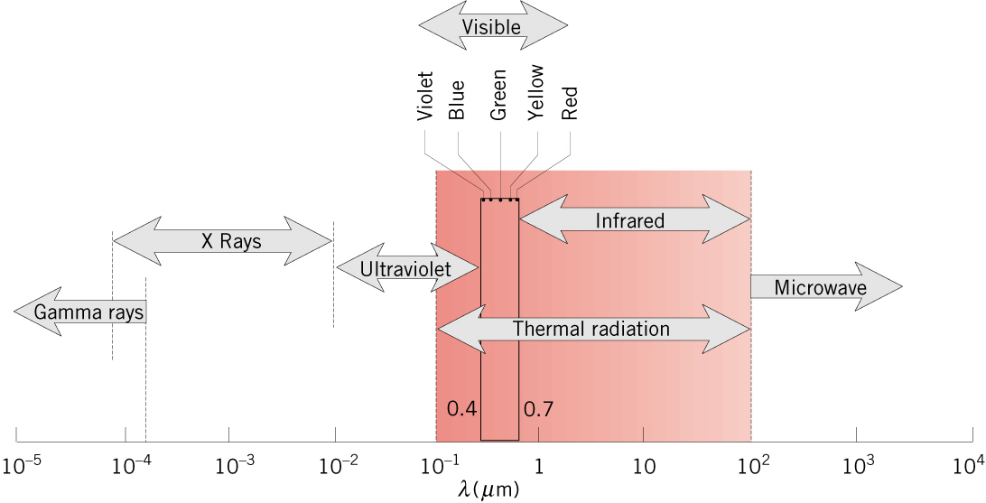
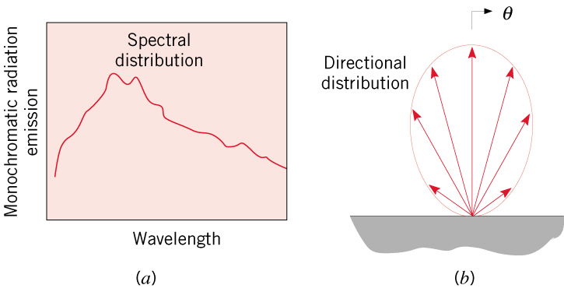
The EM Spectrum
The Electromagnetic Spectrum
Thermal radiation is confined to the infrared, visible and ultraviolet regions of the
spectrum .
The amount of radiation emitted by an opaque
surface varies with wavelength, and we may
speak of the spectral distribution over all
wavelengths or of monochromatic/spectral
components associated with particular wavelengths.

Slide 5
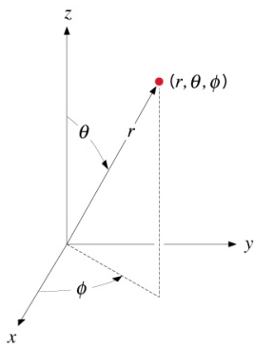

Directional Considerations
Directional Considerations and the
Concept of Radiation Intensity
Radiation emitted by a surface will be in all
directions associated with a hypothetical
hemisphere about the surface and is
characterized by a directional distribution.
Direction may be represented in a spherical
coordinate system characterized by the zenith
or polar angle and the azimuthal angle .
The amount of radiation emitted from a surface,
and propagating in a particular direction,
is quantified in terms of a differential
solid angle associated with the direction.
unit element of surface on a hypothetical sphere and normal to
the direction.

Slide 6
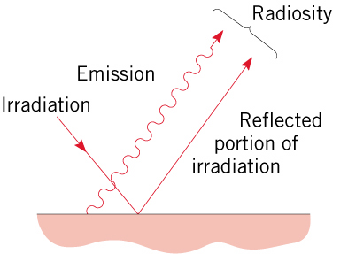
Radiation Fluxes (cont)
The spectral irradiation is then:
and the total irradiation is
The radiosity of an opaque surface accounts for all of the radiation leaving the
surface in all directions and may include contributions to both reflection and
emission.

Slide 7
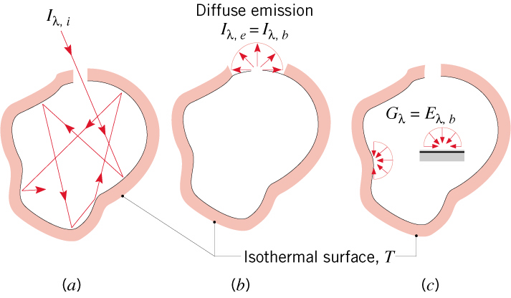
The Blackbody
Blackbody Radiation
The Blackbody
An idealization providing limits on radiation emission and absorption by matter.
For a prescribed temperature and wavelength, no surface can emit
more radiation than a blackbody: the ideal emitter.
A blackbody is a diffuse emitter.
A blackbody absorbs all incident radiation: the ideal absorber.
The Isothermal Cavity (Hohlraum).
(a) After multiple reflections, virtually all radiation entering the cavity is absorbed.
Emission from the aperture is the maximum possible emission achievable for
the temperature associated with the cavity and is diffuse.

Slide 8
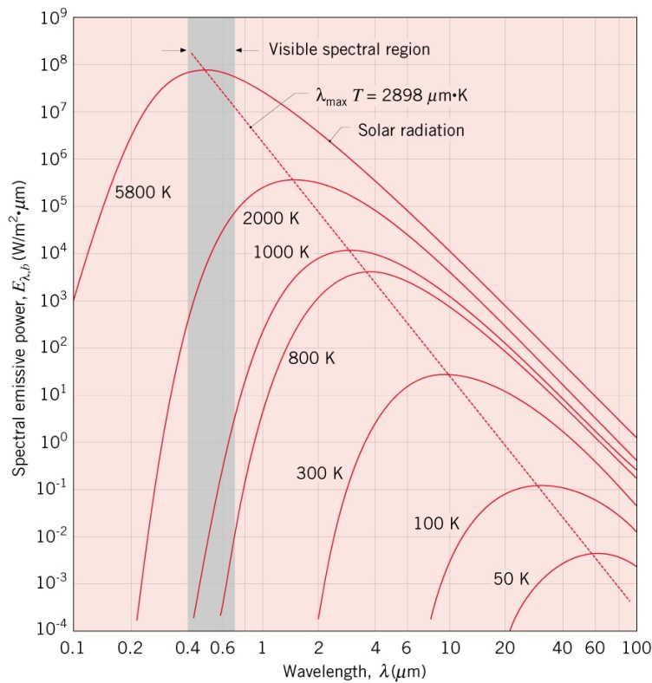
Planck Distribution
The Spectral (Planck) Distribution of Blackbody Radiation
The spectral distribution of the blackbody emissive power (determined
theoretically and confirmed experimentally) is
First radiation constant:
Second radiation constant:

Slide 9
Radiation: Processes and Properties
Surface Radiative Properties
Chapter 12
Sections 12.4 through 12.7

Slide 10
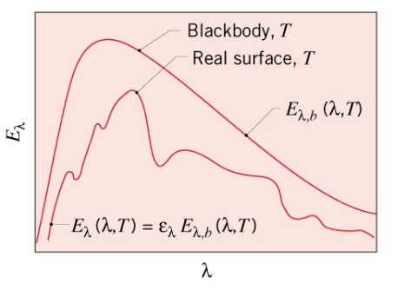
Emissivity
Surface Emissivity
Radiation emitted by a surface may be determined by introducing a property
(the emissivity) that contrasts its emission with the ideal behavior of a blackbody
at the same temperature.
The spectral, hemispherical emissivity (a directional average):

Slide 11
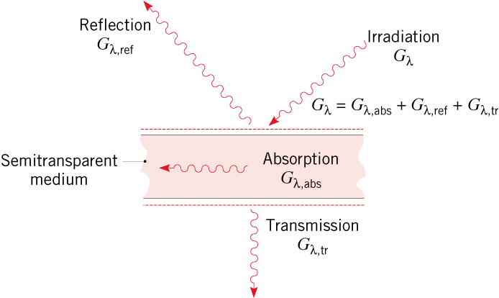
Abs, Ref & Trans
Response to Surface Irradiation: Absorption, Reflection
and Transmission
There may be three responses of a semitransparent medium to irradiation:
Reflection from the medium
Absorption within the medium
Transmission through the medium
Radiation balance
In contrast to the foregoing volumetric effects, the response of an opaque material
to irradiation is governed by surface phenomena and

Slide 12
Radiation: Processes and Properties
- Environmental Radiation -
Chapter 12
Section 12.8

Slide 13
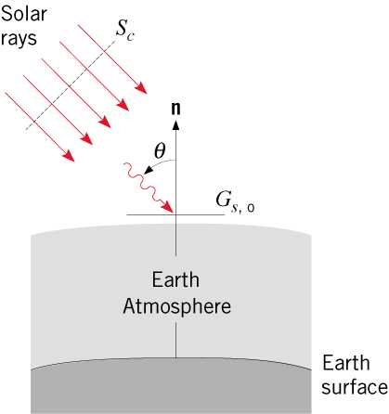

Solar Radiation
Solar Radiation
The sun is a nearly spherical source of radiation whose outer diameter is
1.39 x 10⁹ m and whose emissive power approximates that of a blackbody at 5800K.
The distance from the center of the sun to the center of the earth varies with time
of year from a minimum of 1.471 x 10¹¹ m to a maximum of 1.521 x 10¹¹ m, with
an annual average of 1.496 x 10¹¹ m.
Due to the large sun-to-earth distance, the sun’s rays
are nearly parallel at the outer edge of the earth’s
atmosphere, and the corresponding radiation flux is

Slide 14
Terrestrial Radiation
Terrestrial Radiation
Emission by Earth’s Surface:
Emissivities are typically large. For example, from Table A.11:
Emission is typically from surfaces with temperatures in the range of
250 < T < 320K and hence concentrated in the spectral region
with peak emission at

Slide 15
Terrestrial Radiation (cont).
Atmospheric Emission:
Largely due to emission from CO₂ and H₂O (v) and concentrated in the
spectral regions
Although far from exhibiting the spectral characteristics of blackbody emission,
earth irradiation due to atmospheric emission is often approximated by a
blackbody emissive power of the form
Cold, clear sky
Warm, overcast sky

